Slide 1
What’s your cupcake strategy to grow your business?
Your cherry on top
- What attracts clients to you?
- How are you visible and valuable to them?
- How do you stay in the fronts of their minds?
Your sprinkles
- What’s your 3rd highest profit center?
- What do customers request of you
often, but they don’t pay you a lot of
money for, and that can lead to
more cake and frosting opportunities?
Your frosting
- What’s your 2nd highest profit center?
- What “flavors” does it come in?
Your cake
- What’s your primary profit center?
- Where do you make the most money?
- What “flavors” does it come in? Think
menus of services or core offerings.

Slide 2
Kathy’s Cupcake Strategy
Kathy’s cherry on top –Weekly blog
Kathy’s sprinkles - Speaking
Core topics:
Networking
Women’s leadership
Kathy’s frosting - Coaching
Presentation coaching
Career coaching
Business coaching
Kathy’s cake - Training
1) Presentation Skills
2) Networking Skills
3) Communications Skills
4) Personal Branding

Slide 3
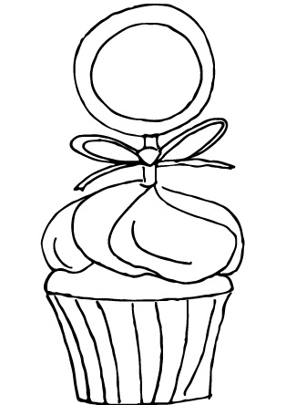
Go Ahead Create your own cupcake strategy
Choose the cupcake template that best fits your personality
Original Illustrations by Marissa McAfee

Slide 4
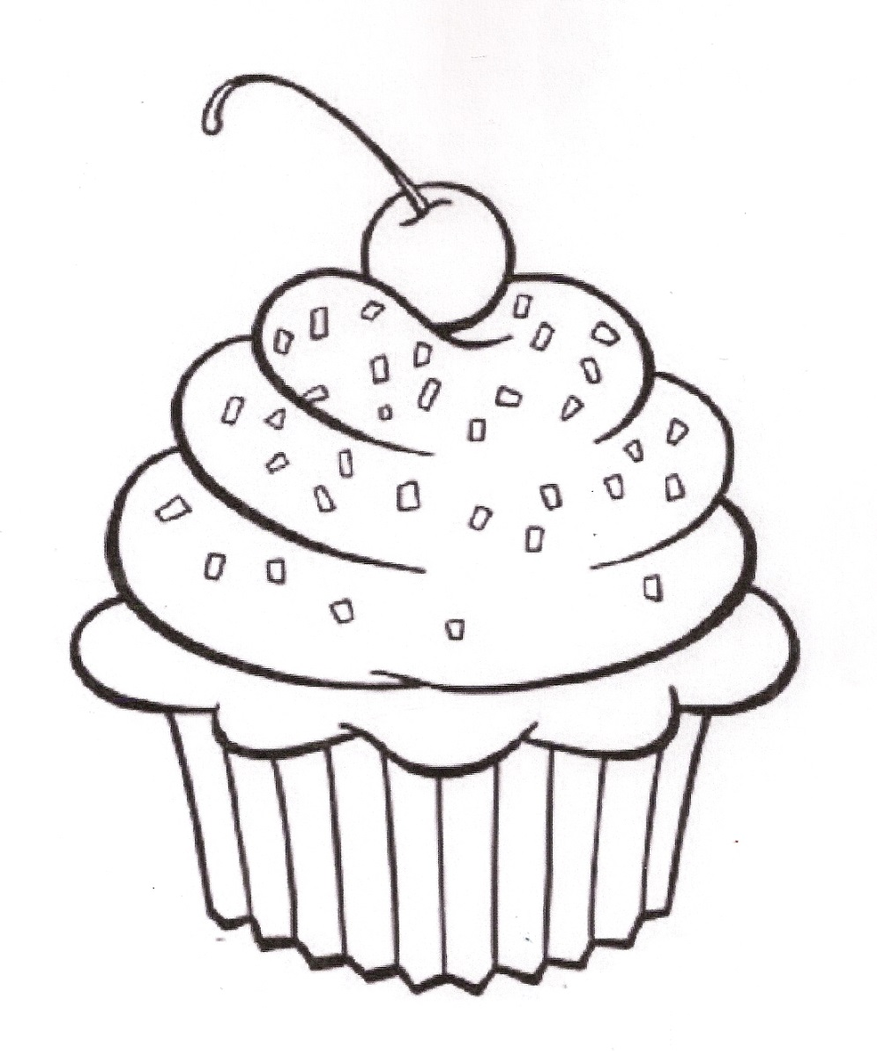
Your cupcake strategy
Your cherry on top
Your sprinkles
Your frosting
Your cake

Slide 5
Your cupcake strategy
Your cherry on top
Your sprinkles
Your frosting
Your cake

Slide 6
Your cupcake strategy
Your cherry on top
Your sprinkles
Your frosting
Your cake

Slide 7
Your cupcake strategy
Your cherry on top
Your sprinkles
Your frosting
Your cake

Slide 8
Your cupcake strategy
Your cherry on top
Your sprinkles
Your frosting
Your cake

Slide 9
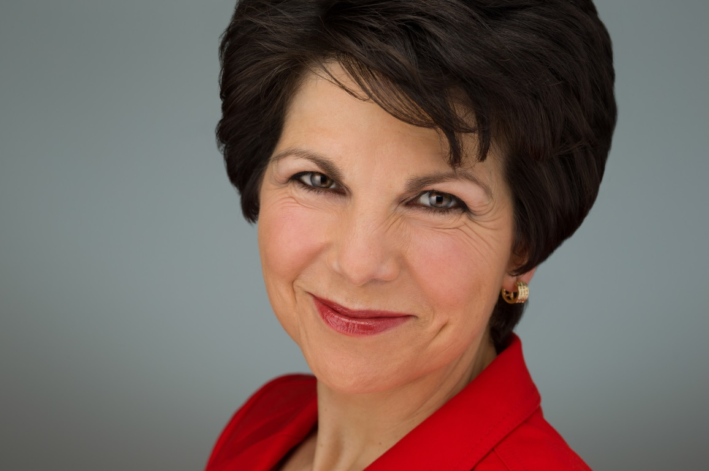
Need a business coach?
I can help you grow
your business!

